Slide 1
McLaren High Performance Network New Participant Onboarding
Kim Hamm, VP Clinical Operations
Dawn Smith, Program Manager
2022

Slide 2
Accountable Care Organization
McLaren High Performance Network, LLC
What is an ACO?
Accountable Care Organizations, (ACOs) are groups of hospitals, providers and community partners who come together to improve patient outcomes and reduce health care costs by delivering highly coordinated care.

Slide 3
Definitions
Participant – participate at the Tax ID (TIN) level
Provider/Supplier – may be physicians, APPs, and other provider types
Beneficiary – this program includes Traditional Medicare Fee for Service patients only, not Medicare Advantage
Attributed Beneficiary – assigned to the provider based on the plurality of primary care services rendered to a beneficiary.

Slide 4
Keys to Success in Value-Based Care
Quality Improvement
Better outcomes and improved patient satisfaction drive stronger patient engagement and cost-efficient outcomes
Care Coordination
Coordinating care to manage chronic disease in populations and improve health outcomes
Cost and Utilization
Eliminating unnecessary care and reducing total costs results in shared savings for patients, employers, health plans, and providers

Slide 5
Quality Metrics
ACOs are scored on the following quality metrics on an annual basis.
Consumer Assessment of Healthcare Providers and Systems (CAHPS) patient experience survey
Hospital-Wide, 30-day, All-cause Unplanned Readmission Rate
Risk Standardized, All-Cause Unplanned Admissions for Multiple Chronic Conditions
Hemoglobin A1c (HbA1c) control
Preventive Care and Screening: Screening for Depression and Follow-up Plan
Controlling High Blood Pressure
Falls: Screening for Future Fall Risk
Preventive Care and Screening: Influenza Immunization
Preventive Care and Screening: Tobacco Use: Screening and Cessation
Colorectal Cancer Screening
Breast Cancer Screening
Statin Therapy for the Prevention and Treatment of Cardiovascular Disease
Depression Remission at Twelve Months

Slide 6
Optimizing Quality Performance
Utilize MPP Top Ten Quality Metric Resource Guide
Provided to you
CPTII Coding, where applicable
Quick reference foldout and encounter type form also provided to you
Integration of your EMR with Persivia, Population Health Tool
Provides gaps in care

Slide 7
Risk Optimization Optimal reflection of a population’s care needs by capturing more complete diagnosis, resulting in higher and more appropriate reimbursement and improved care delivery for complex patients
Use Medicare Annual Wellness Visits (AWV) to close quality and risk gaps
Patient lists provided to you quarterly
HCC Coding to highest specificity (Average HCC target is 1.0 or higher)
Quick reference foldout provided to you
Review the number of codes able to be billed in your EHR on a single encounter. Will want to allow at least 12 codes per claim.
Some EHRs limit the number of codes that can be included on a claim

Slide 8
Managing Costs
McLaren Network Utilization
Use of in-network providers and facilities
Access to Clinical Decision Maker 24/7
After hours contact for patients to reduce visits to Urgent Care/ED
High Value Care
Non-duplication of services
Right place, right time, right service

Slide 9
Downside Risk is here to stay
Medicare, Medicaid and Commercial Payors (Employers) are requiring (Value-Based) Upside and Downside Gain sharing contracts where providers are at risk for the cost and quality of care provided to patients.

Slide 10
Downside Risk
Downside risk is the financial risk associated with losses.
In a downside risk model, providers must refund the payer for the incurred losses if they exceed financial benchmarks.
What does it mean for providers?
Low performers placed on improvement plans
Potential removal from contract
McLaren is at risk for financial performance of all providers as a group
Providers are not at individual financial risk at this time

Slide 11
Downside Risk- What do I need to do?
Physicians are required to participate in:
MPP Care Coordination programs including managing patient transitions among care settings to home
Utilization of evidence-based guidelines to deliver the most effective care in the most appropriate setting

Slide 12
Downside Risk – Best Practices
Physician Engagement/Education
Watch videos on website
Optimize Coding
HCC
CPT II Codes
Persivia Physician Access
Utilize in-network providers and facilities

Slide 13
How Care Coordination Impacts Quality & Cost
Chronic Care Management (CCM) - encompasses a variety of services to support disease management and improve outcomes while reducing avoidable cost; while patients are enrolled in CCM, our team focuses on:
Screening Compliance
Colorectal
Mammogram
Fall Risk
Depression
Immunizations (Flu/Pneumonia)
Diabetic Management Measures
HgbA1C testing
Eye Exams
Reduce Utilization
ED Visits
Hospitalization/Readmissions

Slide 14
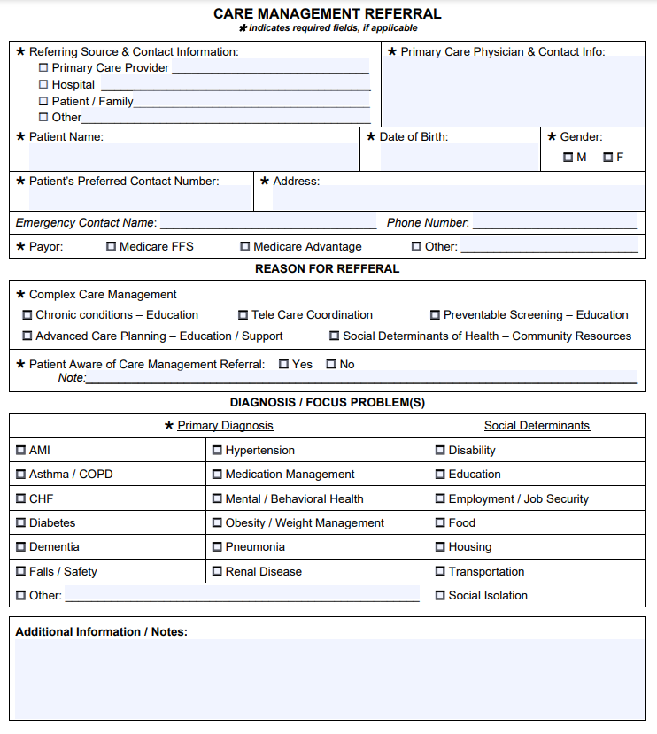
Care Coordination Referrals
McLaren Physician Partners Accepts Referrals from our Members
Ideal referrals include:
Patients with educational needs
Patients newly diagnosed with a chronic condition
Patients who would benefit from Disease Management
Patients needing assistance with Coordinating Care
Patients in need of Community Resources/Social Determinant Concerns
https://www.mclaren.org/mclaren-physician-partners/care-management-referrals

Slide 15
Reports
Below is an example of a report you will receive monthly from the Quality department
Beneficiaries – Medicare Fee for Service (non-Medicare Advantage) beneficiaries attributed based on plurality of care
HCC Score – Hierarchical Condition Category – sum of the score or weight attributed to each of the demographic factors and HCCs within the model, normalized to 1.0
PBPY – Average Cost Per Beneficiary Per Year
Leakage – Claims processed for services outside of the McLaren Network
AWV- Completion rate of eligible Annual Wellness Visits
TOC – Patients seen by PCP within 7-14 days of an inpatient stay

Slide 16
Questions?
Please contact:
Dawn Smith
Program Manager
Compliance Officer
dawn.smith@mclaren.org
248-484-4942

